Slide 1
TITTLE : "Tesla EV Sales Analysis and Prediction"
Subtitle:
"Data Analysis and Machine Learning Project"
NAME : ABIR DATTA

Slide 2
Objective
"Predict factors influencing Tesla's EV sales to guide future market expansion strategies."
Key Deliverables:
Data Preprocessing & Cleaning
Exploratory Data Analysis (EDA)
Feature Engineering
Model Building & Evaluation
Interpretation & Recommendations

Slide 3
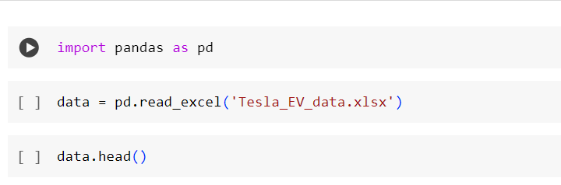
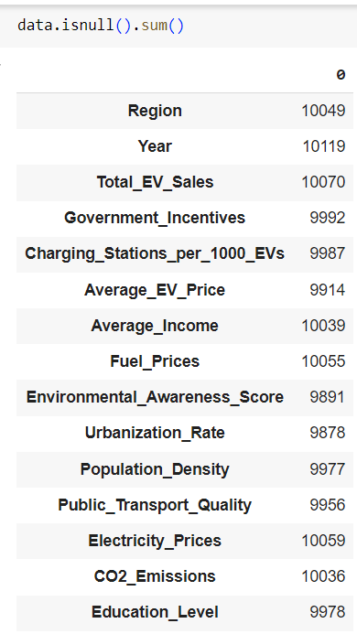
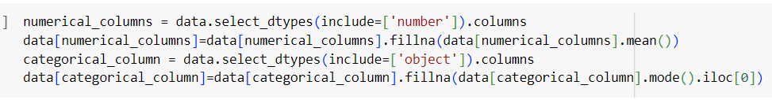
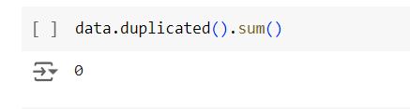
DATA PREPROCESSING
LOADING THE DATASET
Identify and handle missing values appropriately.

Slide 4
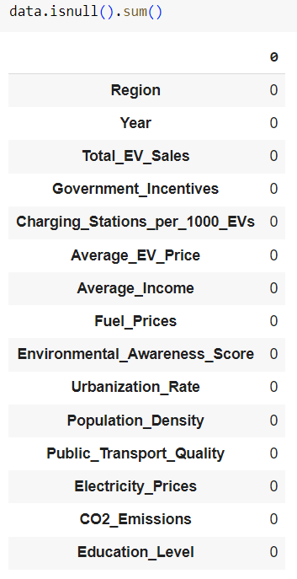
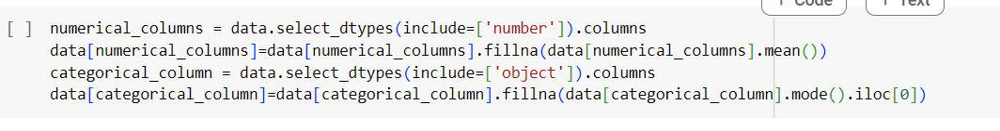
3.Encode categorical variables using suitable encoding techniques

Slide 5
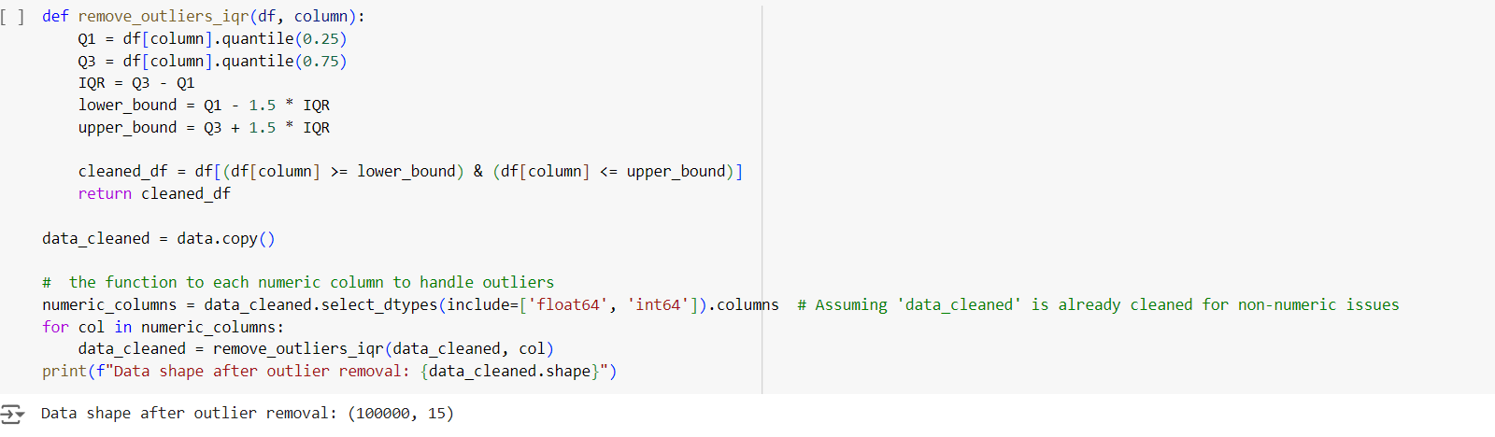
Data Cleaning
Handle any outliers in the dataset.

Slide 6
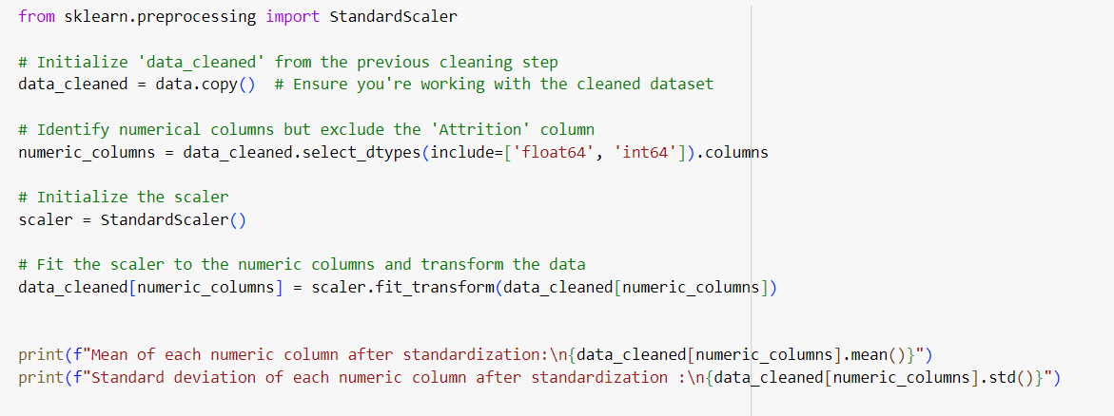
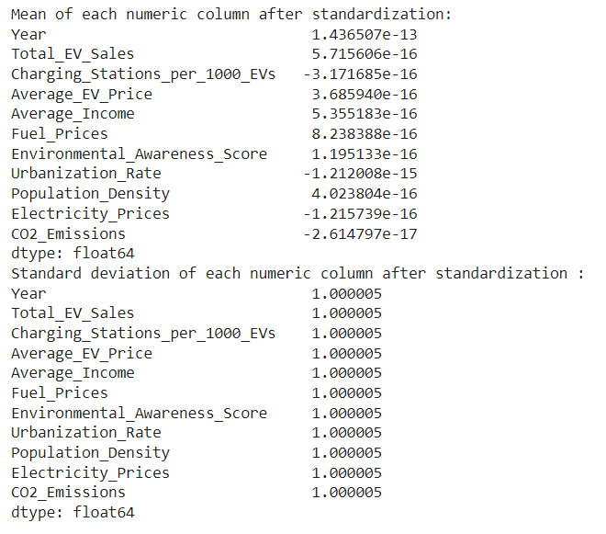
Data Standardization

Slide 7
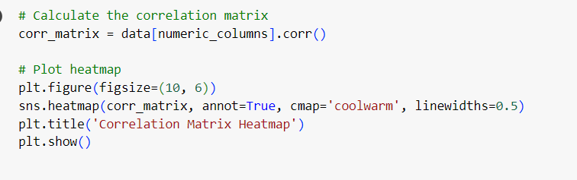
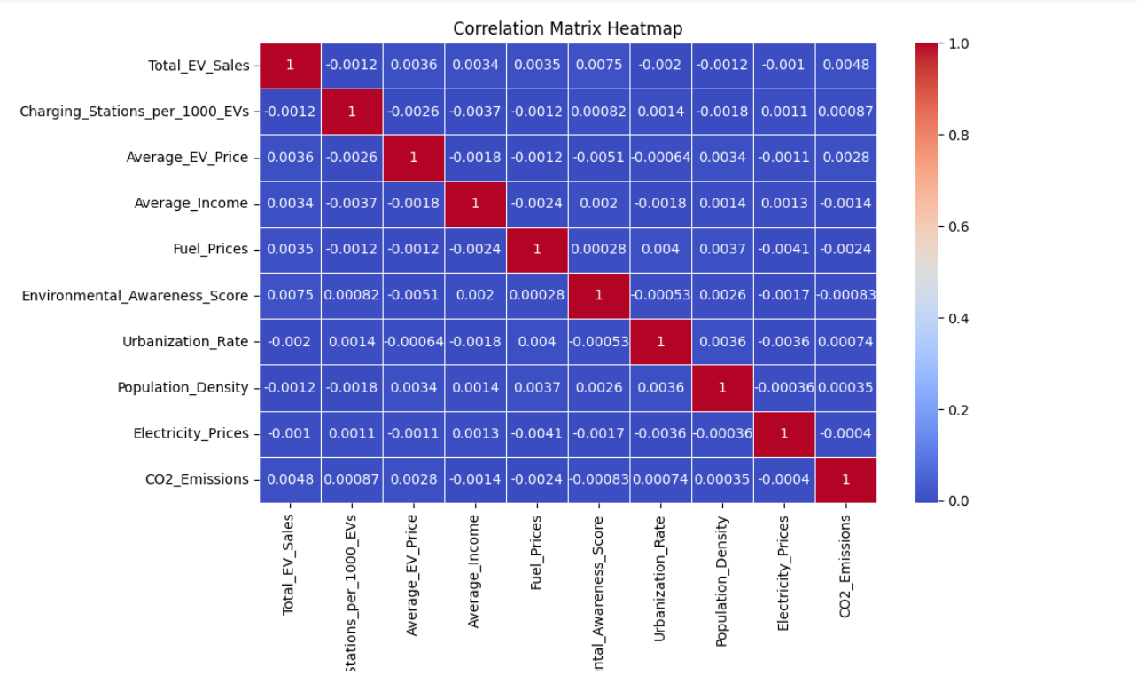
Exploratory Data Analysis
Visualize the data using plots
VISUALIZATIONS:

Slide 8
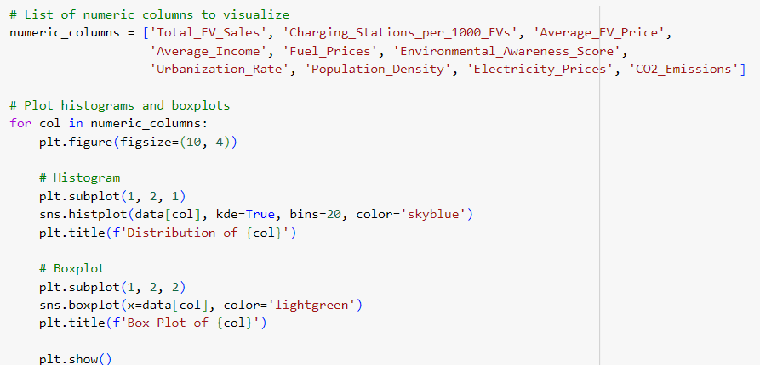
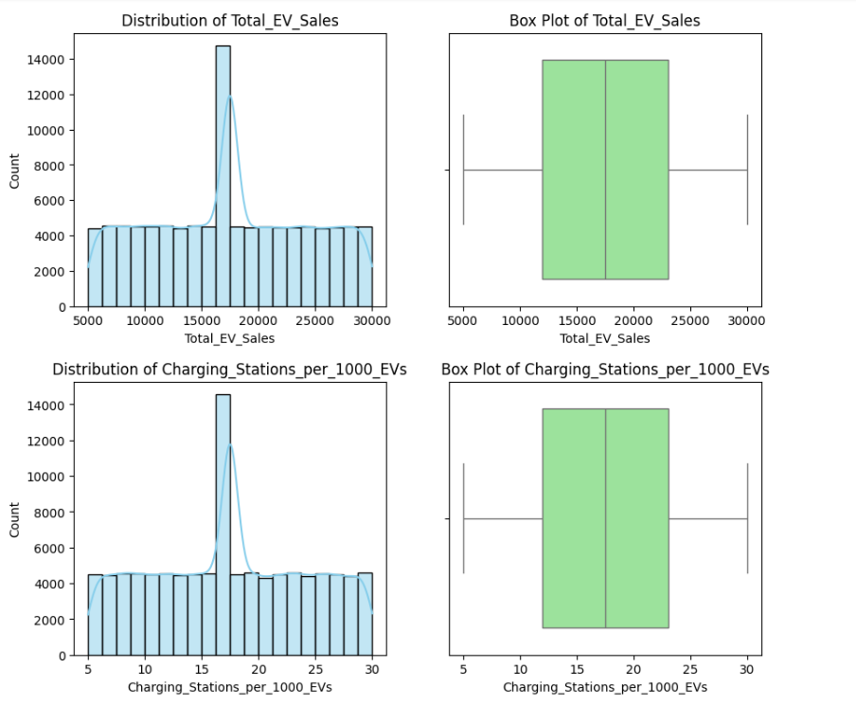
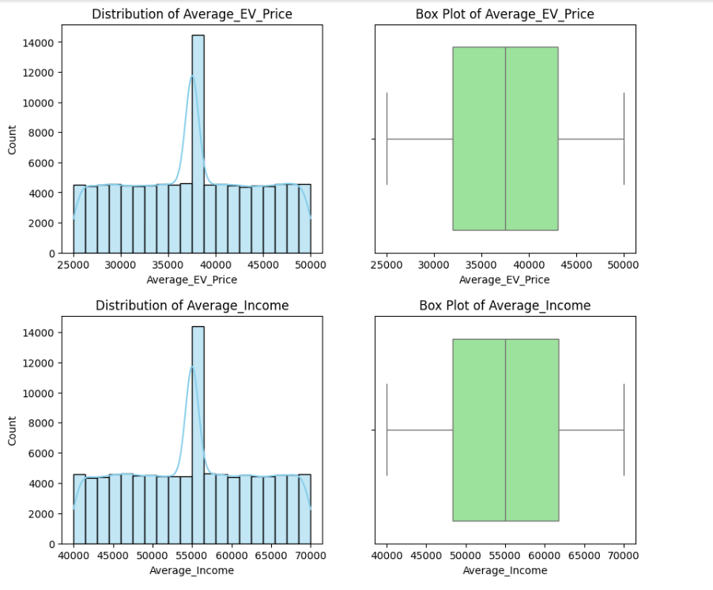
VISUALISATIONS FOR NUMERICAL COLUMNS

Slide 9
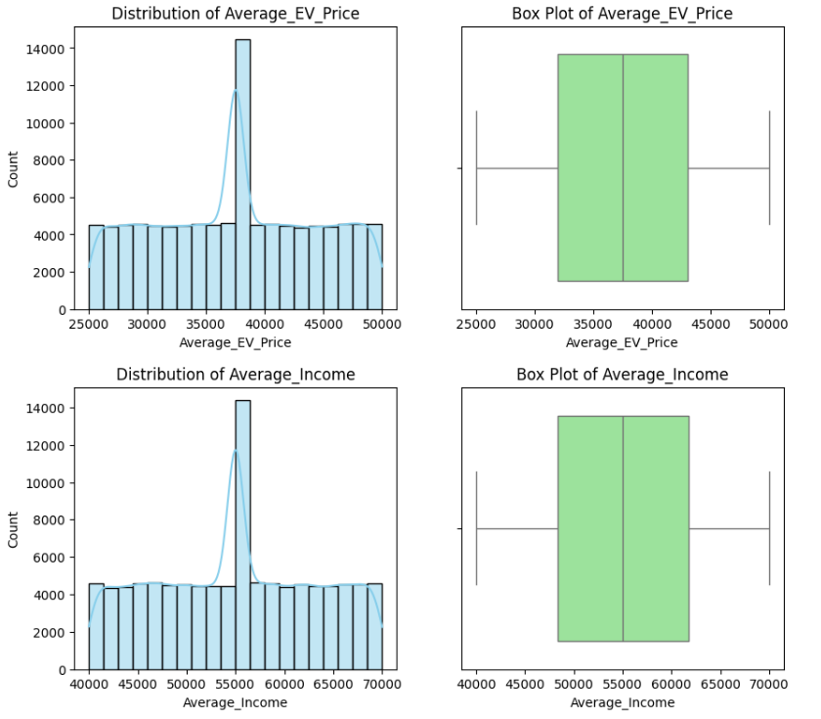
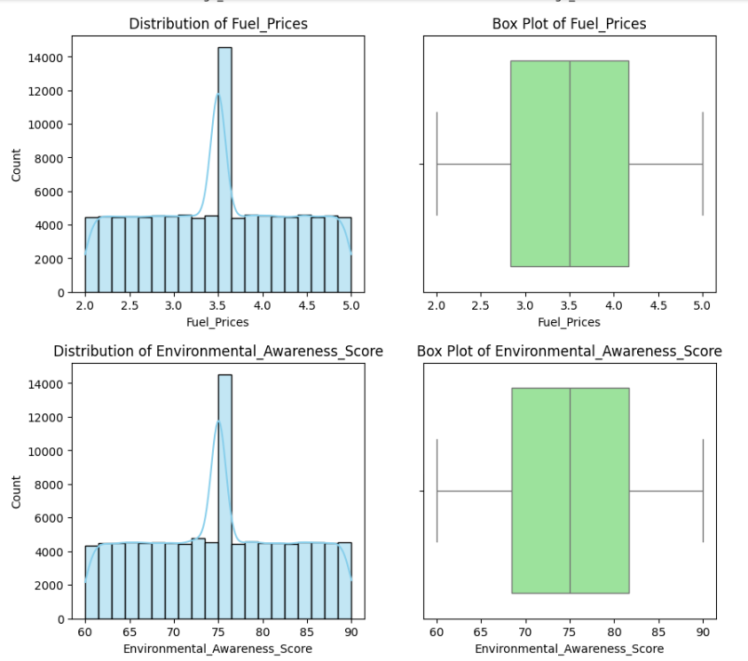

Slide 10
KEY INSIGHTS
Weak Correlations: Most features have very low correlations with Total EV Sales, indicating weak or no linear relationships with Tesla sales.
Charging Stations: A near-zero negative correlation suggests that more charging stations don’t significantly impact EV sales.
EV Price: The average EV price shows almost no correlation with sales, meaning price alone doesn’t drive sales.
Environmental Awareness: There’s a weak positive correlation with EV sales, suggesting awareness might have a small influence.
CO2 Emissions: Slight positive correlation with sales, but the impact is minimal.

Slide 11
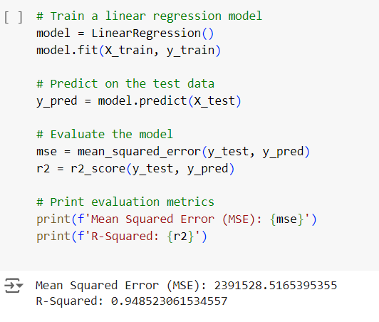
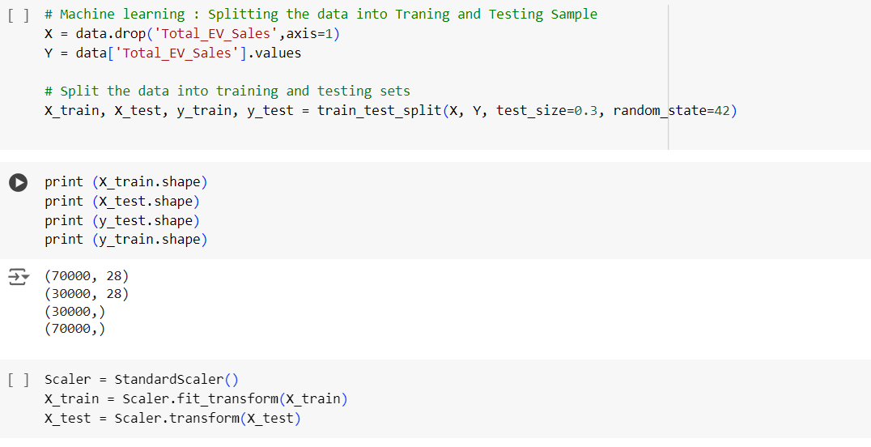
Model Building

Slide 12
Interpretation and Reporting

Slide 13
Report:
Environmental Awareness: Positively associated with EV sales, indicating that regions with higher awareness are more likely to adopt EVs.
Urbanization Rate: Slightly positively correlated with sales, suggesting that Tesla should target urban areas with higher potential for infrastructure development.
Minimal Influence of Charging Stations: Surprisingly, the number of charging stations per 1,000 EVs did not show a strong influence on sales, indicating that other factors (e.g., convenience or subsidies) might be more important to consumers.
Recommendations for Tesla:
Target Urban Markets: Focus on expanding sales in highly urbanized regions, where the adoption rate for EVs is higher.
Leverage Environmental Awareness Campaigns: Invest in marketing campaigns that emphasize the environmental benefits of Tesla’s EVs, especially in regions with high environmental awareness.
Incorporate Policy and Technological Advancements: Consider integrating data on government incentives, tax breaks, and technological advancements like battery innovation into future predictive models to capture additional factors driving sales.
Monitor Charging Infrastructure: Even though charging stations did not show a strong impact on sales, continuous development of Tesla’s Supercharger network will remain crucial for long-term growth, especially as more EV competitors enter the market.

Slide 14
GITHUB LINK :
https://github.com/Abi0p/Predicting_Electiric-_vehicle_adoption_using_Machin_learnig_and-_python-

